Slide 1
Using Ultrasound Technology to Measure Sarcopenia
Daren Heyland, MD, MSc.
Professor of Medicine
Queen’s University, Kingston General Hospital
Kingston, ON Canada

Slide 2
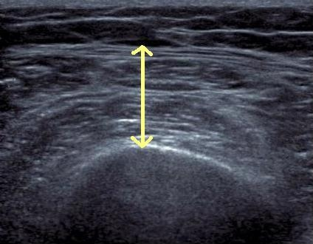
Why Diagnose sarcopenia (Low muscle mass) in the ICU?
Prognostically important***
Monitor outcomes of nutrition and rehabilitation both clinically and research studies**
Identification of subgroup of patients who benefit the most from nutrition therapy*
Others?
* Strength of evidence supporting the use

Slide 3
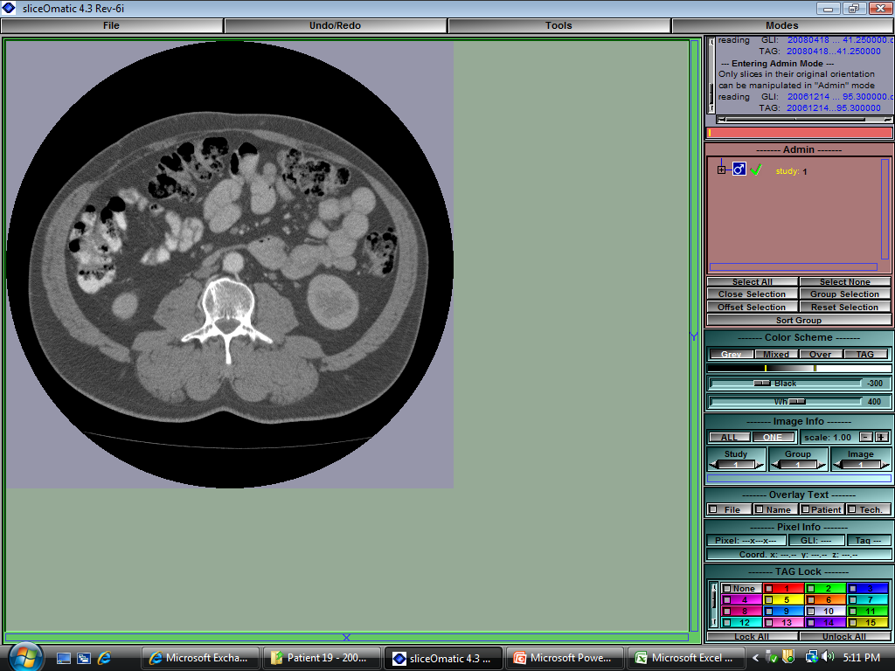
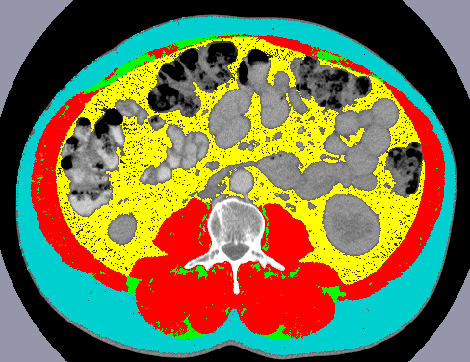
Body Composition Lab CT Analysis
Skeletal Muscle
Adipose Tissue
Images courtesy of Dr. Heyland
Notes:
To date we have used weight/BMI as a descriptor of patient body composition and we have looked at change in weight as a marker of change in nutritional status or to evaluate success/failure of nutritional intervention
However, with weight, we cannot discern specific body composition profile or changes in profile;
Use of already existing CT scans can provide this information…
-L3 bony landmark – literature; longitudinal

Slide 4
Skeletal Muscle is Related to Mortality in Critical Illness
Presence of sarcopenia associated with decreased ventilator-free days (P=0.004) and ICU-free days (0.002)
BMI, fat and serum albumin were not associated with ventilator- and ICU-free days
P=0.018
Moisey LL et al. Crit Care. 2013;17(5):R206.
Notes:
Multivariate linear regression showed that presence of sarcopenia decreased vent-free days and ICU-free days wehre BMI, fat and serum albumin did not.

Slide 5
Background
Need for a non-invasive, easily accessible, bedside tool to measure muscle quantity
Ultrasonography emerging as a potentially accurate tool for muscle quantification

Slide 6
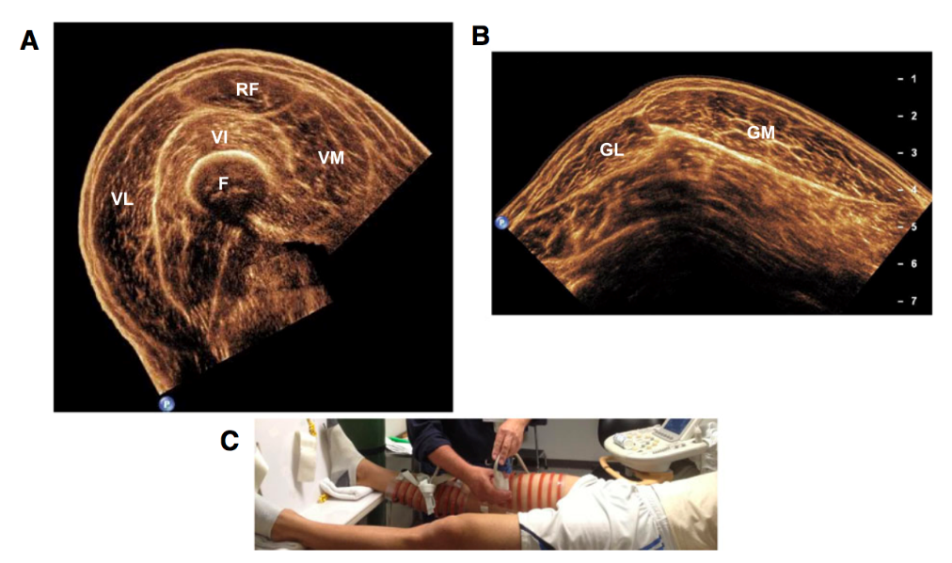
Ultrasonography for Muscle Assessment – Methodological Approaches
Several different approaches developed for muscle thickness
  1-site vs 3-site vs 4-site vs 5-site vs 9-site
  4-site most common
Excellent reliability^{1,2,3}
Few tested against reference methods
Fewer validated in the ICU to referent standards ²
1. Tillquist et al JPEN 2013
2. Paris et al JPEN 2016
3. Sarwal J Ultrasound Med 2015

Slide 7
What do we mean by “Validation”
In a critically ill population:
US measurement really measures what it is measuring
  Compared to some other ‘referent standard’
    Eg. CT measure of thigh or CT estimate of LMM, or other
US measures a ‘change’ that is clinical meaningful
  Predictive validity: the extent to which the US measure predicts scores on some criterion measure.
That we understand what a minimal clinically important difference in the measurement is
  Derived from longitudinal studies with repeated measures where ‘change’ in US compared to some other known/validated change measure.
Notes:
Last night I introduced a validation study on US and DXA in healthy – here we examine ICU based US and CT

Slide 8
Outcomes
Spectrum of Outcome Assessments
Clinically Important
Mortality
QoL
Morbidity
  disease
  complications
  LOS
Nutritional
  weight
  nitrogen balance
  biochemical
Physiology
Lab animals
}
Surrogate
hypothesis
generating
Not Clinically Important
Notes:
What do I mean by surrogate endpoints? This slide contains a list of the kinds of outcomes you would see in RCT’s evaluating nutritional support.
Clinically important endpoints are those that are important from the patient’s perspective, they are relevant to the patient, the patient is aware of them and wants to avoid them.
A surrogate endpoint is usually a laboratory measurement or physical sign used as a substitute for the clinically meaningful endpoint that directly measures how the patients feels, functions or survives. The expectation is that changes induced by a therapeutic intervention on a surrogate endpoint are expected to reflect changes in a clinically meaningful endpoint.

Slide 9
Surrogate Endpoints Useful?
Intervention
Clinically Important Outcome
Disease
Surrogate Endpoint
Time
Fleming, Ann Intern Med 1996
Notes:
The primary motivation for use of surrogate endpoints is related to the possible reduction in sample size or trial duration that we can expect when a rare or distal clinically important endpoint is replaced by a frequent or more proximal endpoint. These reductions have enormous cost implications and therefore the feasibility of such trials.

Slide 10
VALIDation of bedside Ultrasound of Muscle layer thickness of the quadriceps in the critically ill patient: The VALIDUM Study
In a critically ill population, we aim to:
Evaluate intra- and (inter-) rater reliability of using ultrasound to measure QMLT.
Compare US-based quadriceps muscle layer thickness (QMLT) with L3 skeletal muscle cross-sectional area using CT.
Develop and validate a regression equation that uses QMLT acquired by ultrasound to predict whole body muscle mass estimated by CT
Notes:
Last night I introduced a validation study on US and DXA in healthy – here we examine ICU based US and CT

Slide 11
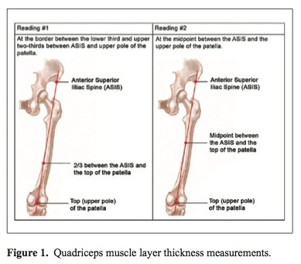
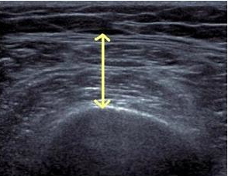
4- point Method
Maximal compression
Tillquist et al JPEN 2013
Gruther et al. J Rehabil Med 2008
Campbell et al. AJCN 1995

Slide 12
Study Design and Population
Prospective, observational study
Heterogeneous population of ICU inpatients
US performed within 72 hrs of CT scan
Inclusion Criteria:
  Abdominal CT scan performed for clinical reasons <24 hrs before or <72 hrs after ICU admission
Exclusion Criteria:
  Moribund patients with devastating injuries and not expected to survive

Slide 13
Participant Characteristics (n=149)
Characteristics | All patients (n=149)
Age (years) | 59±19 (18-96)
Sex
Male | 86 (57.7%)
BMI (kg/m²)* | 29± 8 (17-57)
Underweight | 4 (2.7%)
Normal | 43 (28.9%)
Overweight | 46 (30.9%)
Obesity class I | 56 (37.6%)
APACHE II score | 17± 8 ( 2-43)
SOFA score | 5± 4 ( 0-18)
Charlson comorbidity index | 2± 2 ( 0- 7)
Functional comorbidity index | 1± 1 ( 0- 4)
Characteristics | All patients (n=149)
Admission type
Medical | 87 (58.4%)
Surgical | 62 (41.6%)
Primary ICU admission
Cardiovascular/Vascular | 16 (10.7%)
Respiratory | 10 (6.7%)
Gastrointestinal | 26 (17.4%)
Neurologic | 6 (4.0%)
Sepsis | 56 (37.6%)
Trauma | 23 (15.4%)
Metabolic | 1 (0.7%)
Hematologic | 5 (3.4%)
Other | 6 (4.0%)
ICU mortality | 13 (8.7%)
Hospital mortality | 17 (11.4%)
Notes:
Of the n=191, 149 had usable CT scans, within the correct timeframe. As well as US performed within 72 hrs of CT scan.

Slide 14
  Descriptive Summary of CT Skeletal Muscle Mass and QMLT by Sex and Age
Measurement Mean ± SD | All patients (n=149) | Males (n=86) | Females (n=63) | p-value | Young (<65 years) (n=81) | Elderly (>65 years) (n=68) | p-value
Skeletal muscle index (cm²m²) | 49.0±13.6 | 55.1±13.2 | 40.6±9.1 | <.001 | 53.0±14.8 | 44.1±10.3 | <.001
Skeletal muscle cross sectional area (cm²) | 143.1±43.6 | 168.1±36.6 | 108.5±24.5 | <.001 | 157.4±45.6 | 126.0±34.1 | <.001
Left QMLT (cm) | 1.3±0.6 | 1.5±0.6 | 1.1±0.6 | <.001 | 1.4±0.7 | 1.2±0.5 | 0.41
Right QMLT (cm) | 1.3.±0.6 | 1.5±0.7 | 1.1±0.6 | <.001 | 1.4±0.7 | 1.3±0.6 | 0.65
50% prevalence of low muscularity defined by CT Threshold of <55.4 cm²/m² for males and <38.9 cm²/m² for females
Notes:
Describe the different measures
Why we included cm2/m2 as well as cm2 – becomes important in our results here as well as the BIA results
QMLT – the measures are v.low compared to non-Icu literature – but max compression used here…
QMLT – index – normalized to height squared – we have done this for consistency – is it redundant? Since we are evaluating pairs? Other papers have used limb length to formulate the thigh as a cylinder (which we don’t have but height might be the closest thing to it) → others have multiplied by limb length (and have resulted in stronger correlations)
- Difference between young and elderly may be driven by distribution of males and females in each group – we haven’t analyized this.
Skeletal muscle index (cm²/m²)
Calculated as Muscle CSA as cm2 divided by patient height squared as m2
Estimated whole body muscle mass (kg)
We have a regression equation that we use for this - it is not identified on the excel sheet
Left QMLT (cm)
Ultrasound-based quadricep muscle thickness in cm for the left leg
Right QMLT (cm)
Ultrasound-based quadricep muscle thickness in cm for the right leg
Left QMLT index
LEFT QMLT index divided by patient height squared in m2
Right QMLT index
RIGHT QMLT index divided by patient height squared in m2

Slide 15
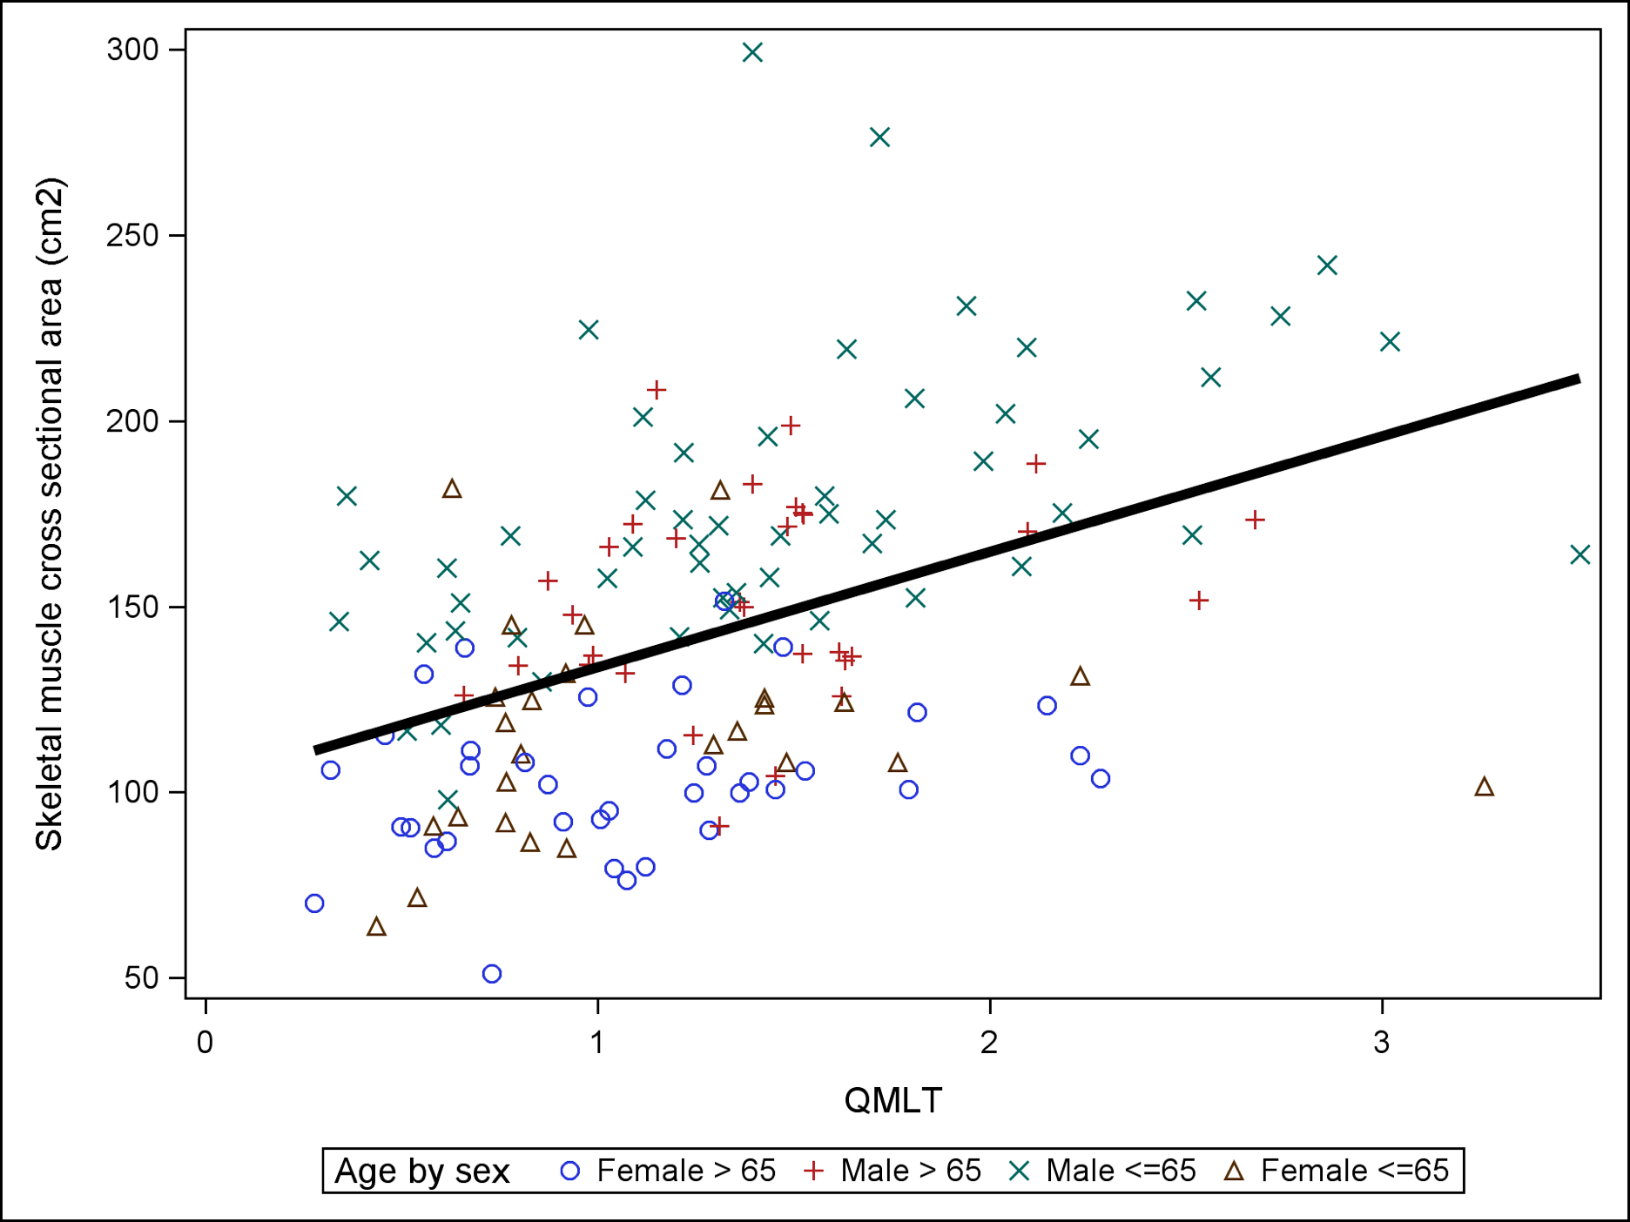
Association Between CT Skeletal Muscle CSA and US QMLT
Pearson correlation coefficient=0.45
P<0.0001
Notes:
Legend: Association between CT skeletal muscle cross sectional area and ultrasound QMLT with linear regression lines superimposed. Overall regression fit: CT skeletal muscle cross sectional area=102.5+31.1*QMLT. Overall Pearson correlation coefficient between CT skeletal muscle cross sectional area and Ultrasound QMLT index is 0.45, p<0.0001
Correlations were performed on each group but only males <65 yrs showed r=0.51 and P<0.05 (however this is likely driving the entire regression; n=?? but broad spectrum of muuscularity)
*Note: included 4 separate groups on the plot (young female, elderly female, young male, elderly male)
Groups
n
Pearson correlation coefficient
p values
Elderly males (≥ 65 yrs)
31
0.24
0.19
Young males (<65 yrs)
55
0.51
<0.0001
Elderly females (≥ 65 yrs)
37
0.26
0.12
Young females (<65 yrs)
26
0.13
0.52

Slide 16
    Ability of QMLT to Predict Low CT Skeletal Muscle Index and CSA by Logistic Regression
Outcome | Low MM/n | Predictors | c | P-value model | P-value QMLT
Low muscle index** | 74/149 | QMLT | 0.618 | 0.007 | 0.007
Low muscle index** | 74/149 | covariates* | 0.712 | 0.005 | NA
Low muscle index** | 74/149 | covariates + QMLT | 0.759 | <0.0001 | 0.0065
Low muscle area*** | 86/149 | QMLT | 0.666 | 0.0016 | 0.0016
Low muscle area*** | 86/149 | covariates* | 0.724 | 0.0008 | NA
Low muscle area*** | 86/149 | covariates + QMLT | 0.767 | <0.0001 | 0.0047
*Covariates are: age (linear), sex (binary), BMI (linear), Charlson comorbidity index (linear) and admission type (binary). **Low muscle index is defined as <55.4 cm²/m² for males and <38.9 cm²/m² for females. ***Low muscle area is defined at <170cm² for males and <110 cm² for females. Variance inflation factor for QMLT in model with all covariates is 1.2 NA – not applicable
Notes:
Model is considered reasonable when c>0.7; strong when c>0.8 – moderately strong when combined covariates and QMLT – similar to previous slide using linear regression

Slide 17
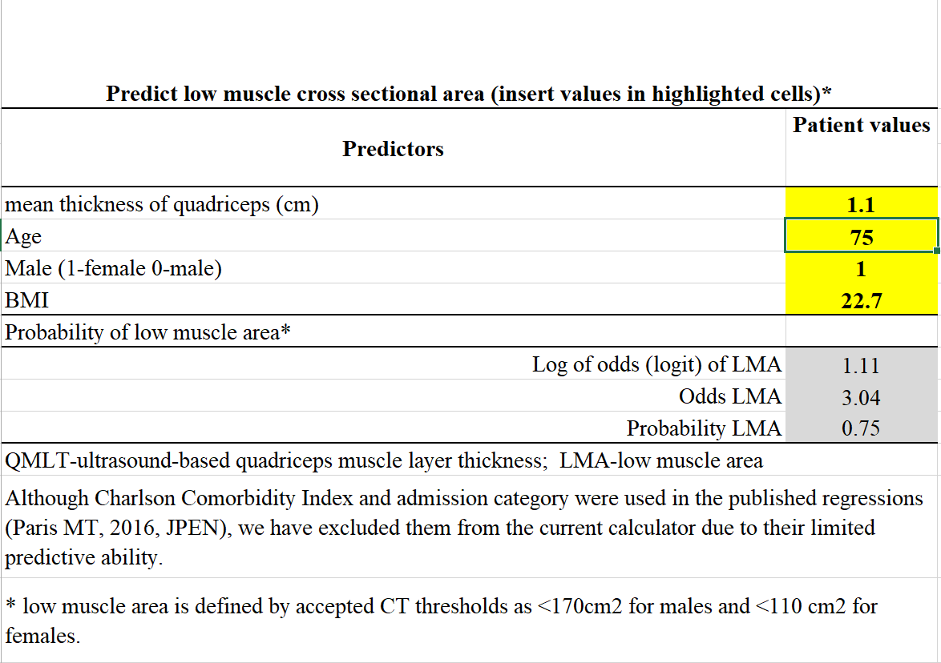
Probability of low muscle mass calculator
Available on www.criticalcarenutrition.com

Slide 18
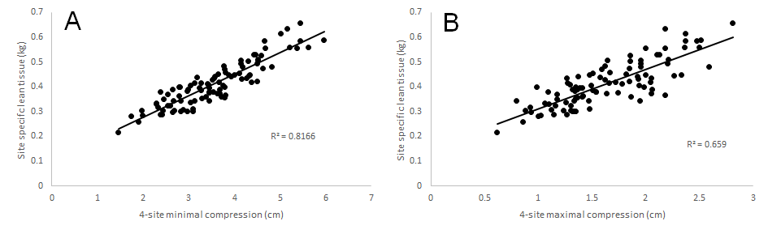
Evaluation of different ultrasound protocols against DXA in Healthy volunteers
R2=0.66
R2=0.82
Minimal compression better
Applicability to ICU patient (edema)?
Paris et al JCSM April 2017

Slide 19
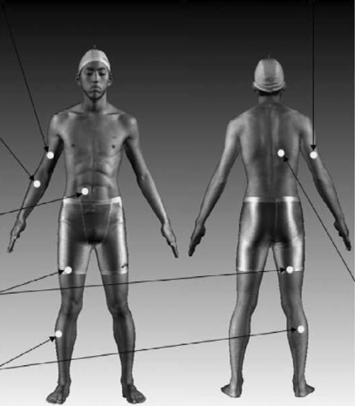
Evaluation of different ultrasound protocols against DXA in Healthy volunteers
Compared 9-protocol to DXA
four-site protocol was strongly associated with appendicular lean tissue mass
(R2 = 0.72)
Using regression models, demonstrated that a 5-site (upper anterior arm, 4 lower limb)
protocol + age + sex: r² = 0.91
Applicability to ICU patient?
Paris et al JCSM April 2017

Slide 20
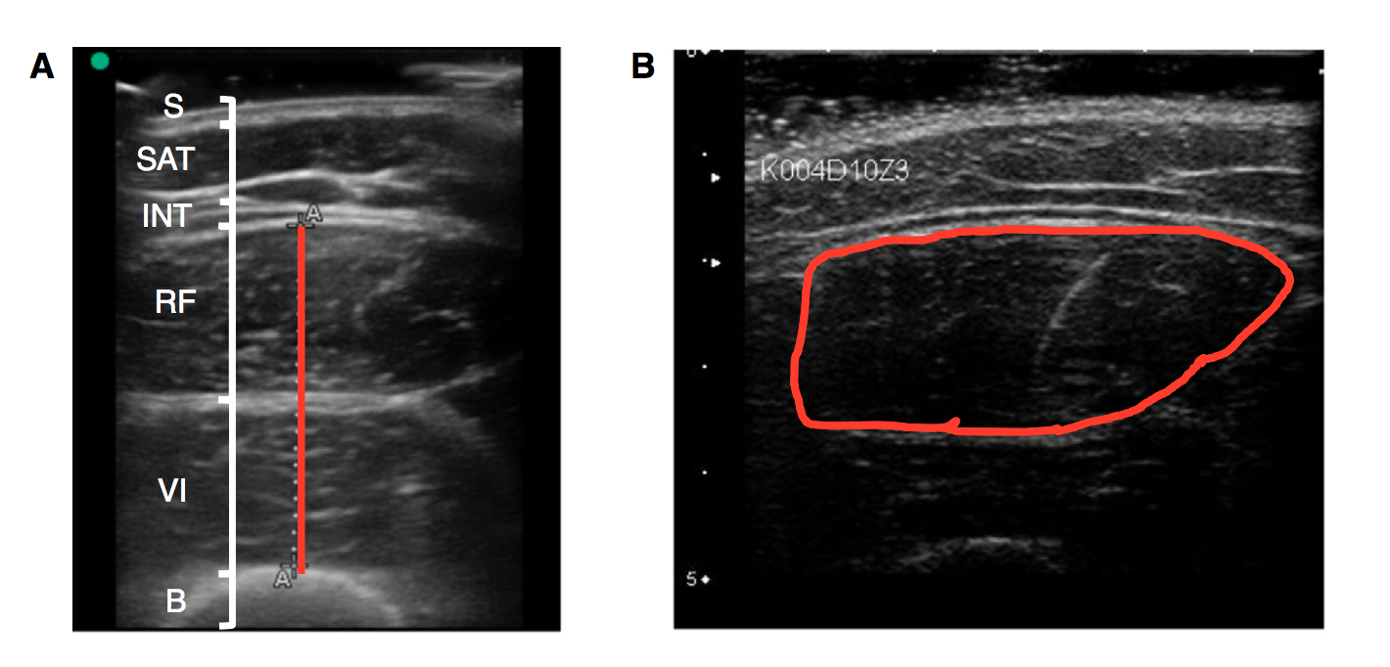
Quantifying Muscle with Ultrasound
Mourtzakis, Parry, Connolly, Puthucheary. Ann Am Thorac Soc. In Press.

Slide 21
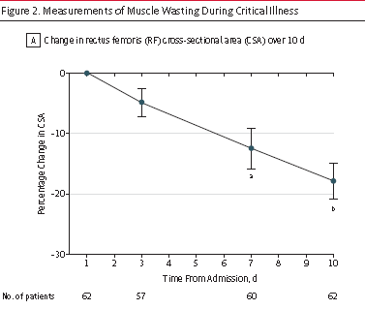
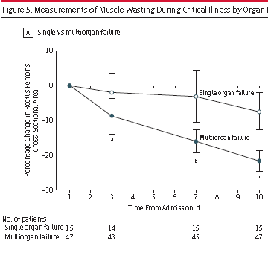
Acute Skeletal Muscle Wasting in Critical Illness
Puthucheary JAMA Published online Oct 9, 2013

Slide 22
Rectus Femoris Cross-Sectional Area and Muscle Layer Thickness: Comparative Markers of Muscle Wasting and Weakness
Puthucheary AmJRCCM 2017;195:136

Slide 23
Quality vs. Quantity

Slide 24
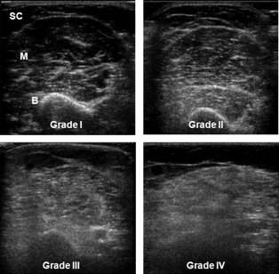
Heckmatt Grading Scale
Grade 1: Predominantly dark muscle (M) with subcu fat (SC) and echogenic bone (B)
Grade 2: Increased echogenicity in the muscle, preserved bone reflection
Grade 3: Increased echogenicity with decreased bone reflection
Grade 4: Markedly increased echogenicity, absent bone reflection

Slide 25
Ultrasonography in the intensive care setting can be used to detect changes in the quality and quantity of muscle and is related to muscle strength and function
22 critically ill patients
US at baseline and then followed for functional capacity at ICU discharge
There was a 30% reduction in vastus intermedius (VI) thickness, rectus femoris (RF) thickness, and cross-sectional area within 10 days of admission.
Muscle echogenicity scores increased for both RF and VI muscles by +12.7% and +25.5%, respectively (suggesting deterioration in muscle quality).
Parry JCC 2015

Slide 26
Ultrasonography in the intensive care setting can be used to detect changes in the quality and quantity of muscle and is related to muscle strength and function
Changes in thickness more predictive than loss of CSA??
Parry JCC 2015

Slide 27
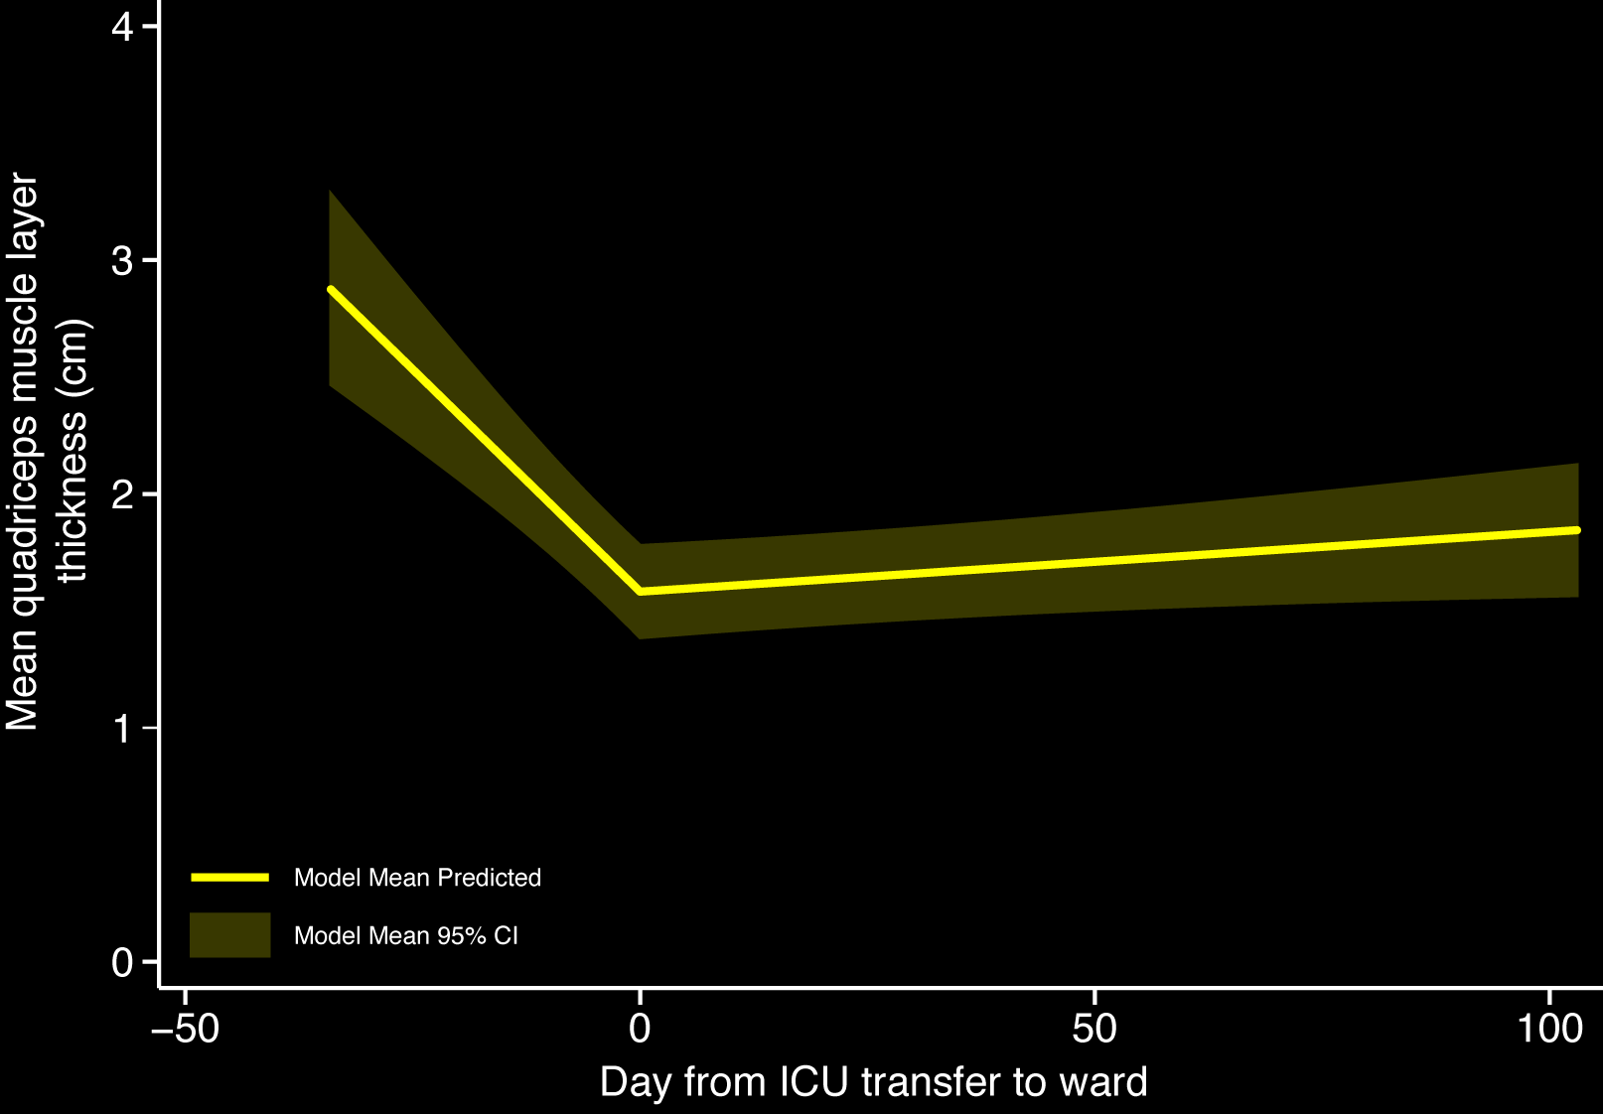
Longitudinal changes in quadriceps thickness & impact on self-reported physical function following traumatic brain injury
Chapple CCR 2017 (in press)

Slide 28
Relationship between anthropometry and self-reported outcomes:
Positive correlation with:
  SF-36 physical component summary score at 3-months and quad thickness at hospital discharge (r=0.536, p=0.010) and at 3-months (r=0.658, p=0.020).
  GOS-E at 3-months and Quad thickness, both at hospital discharge (r=0.595, p=0.003), and at 3-months (r=0.642, p=0.025)
Chapple CCR 2017 (in press)

Slide 29
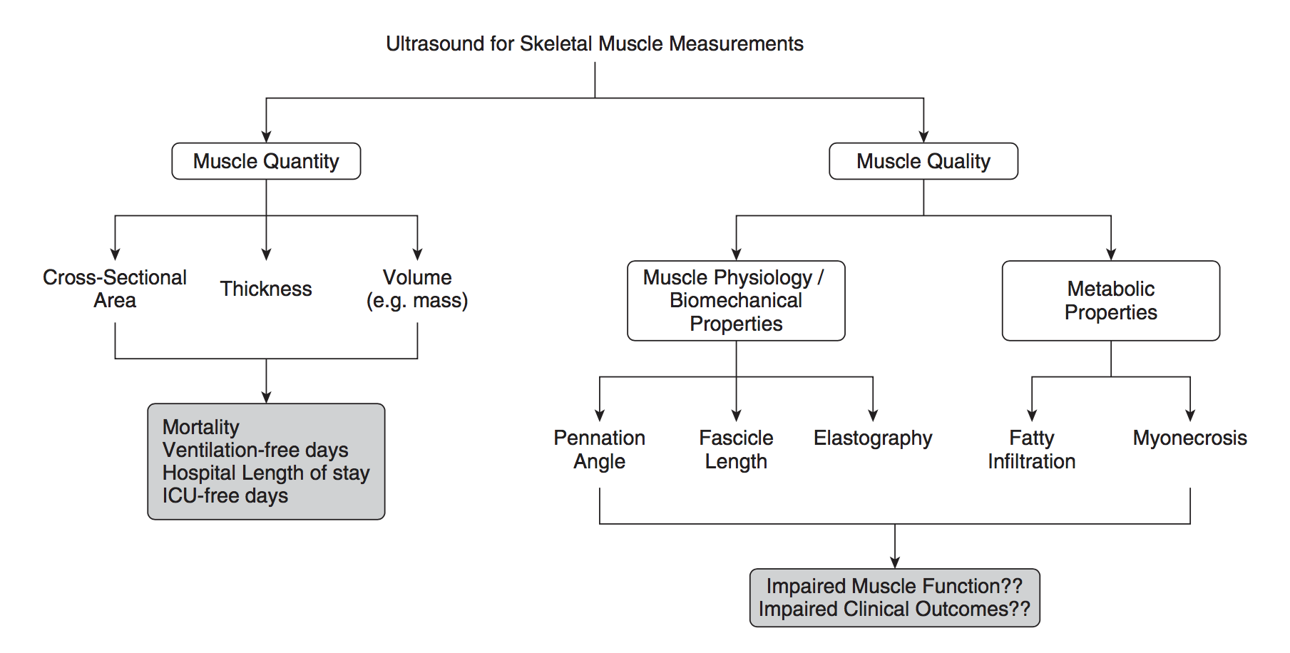
Skeletal Muscle Health:
Measurements using Ultrasound
Mourtzakis, Parry, Connolly, Puthucheary. Ann Am Thorac Soc. In Press.

Slide 30
Implications for Practice and Resaerch
Ready for daily use?
  Low level evidence that baseline measures predict for poor outcomes
  What thresholds are to be used?
  Low level evidence that changes in US are meaningful
  Low level of evidence that a delta value can be an outcome measure
  What is MCID? Responsiveness?
More research needed!

Slide 31




The NEXIS Study
(Nutrition and EXercise Interventional Study in critically ill patients)
Bedside cycling ergometry
and IV amino acids
(2-2.5 grams/kg/day)
Primary Outcome
6 min WD
142 ICU patients
Projected length of
stay >3 days
R
Concealed Stratified by
Site
Secondary Outcome
HRQOL
ADL/IADL
Muscle strength
Fed enterally
Usual Care
(bed rest and underfeeding)
In collaboration with Renee Stapleton and Dale Needham
Funded by NIH

Slide 32
Secondary Outcomes
Secondary Outcomes (In-Hospital)
Body Composition: Ultrasound Thigh (thickness, RF CSA, quality) Deuterium dilution (patient subset) CT of 3rd lumbar vertebra (when clinically available) Amino acid metabolism tracer studies (patient subset) Muscle strength: MRC sum-score (arm and leg muscle groups) Quadriceps force (handheld dynamometry) Hand grip strength

Slide 33
Secondary Outcomes
Domain | Secondary Outcomes
Survival | Mortality
Physical function | FSS-ICU (Functional Status Score for the ICU) SPPB (Short Phys. Perf. Battery) – incl. 4 meter walk
Standard ICU/Hospital Outcomes | ICU/hospital LOS Hospital-acquired infections Discharge location

Slide 34
6 mo. phone (incl NIH COS)
Domain | Secondary Outcomes
Quality of Life | EQ-5D-5L + SF-36 v2
Mental Health and Cognition | HADS, IES-R, MoCA-BLIND
Participation measures | ADL/IADL Living location Time to return to work/prior activity Healthcare utilization Days Alive At Home (DAAH) over 180 days

Slide 35
The NEXIS Study
(Nutrition and EXercise Interventional Study in critically ill patients)
US of quadriceps at baseline, ICU and Hospital Discharge
4 point protocol with minimal compression
Will asses thickness, RF CSA, and echogenicity
Aim to compare between groups and correlate with long-term outcomes
Protocol available on request

Slide 36
Conclusions
Need better ways to assess to diagnose low muscularity
US of quadriceps has potential to be useful
More validation work needed once optimal protocol sorted out
More research needed

